Slide 1
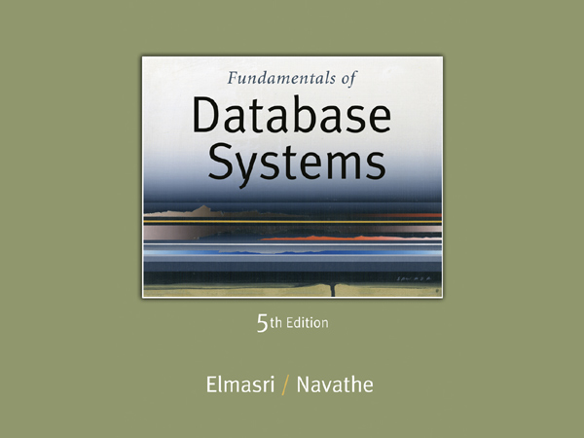

Slide 2
Chapter 6
The Relational Algebra

Slide 3
Chapter Outline
Relational Algebra
  Unary Relational Operations
  Relational Algebra Operations From Set Theory
  Binary Relational Operations
  Additional Relational Operations
  Examples of Queries in Relational Algebra
Example Database Application (COMPANY)

Slide 4
Relational Algebra Overview
Relational algebra is the basic set of operations for the relational model
These operations enable a user to specify basic retrieval requests (or queries)
The result of an operation is a new relation, which may have been formed from one or more input relations
  This property makes the algebra “closed” (all objects in relational algebra are relations)

Slide 5
Relational Algebra Overview (continued)
The algebra operations thus produce new relations
  These can be further manipulated using operations of the same algebra
A sequence of relational algebra operations forms a relational algebra expression
  The result of a relational algebra expression is also a relation that represents the result of a database query (or retrieval request)

Slide 6
Relational Algebra Overview
Relational Algebra consists of several groups of operations
  Unary Relational Operations
    SELECT (symbol: σ (sigma))
    PROJECT (symbol: π (pi))
    RENAME (symbol: ρ (rho))
  Relational Algebra Operations From Set Theory
    UNION ( ∪ ), INTERSECTION ( ∩ ), DIFFERENCE (or MINUS, – )
    CARTESIAN PRODUCT ( x )
  Binary Relational Operations
    JOIN (several variations of JOIN exist)
    DIVISION (We will not cover it)

Slide 7
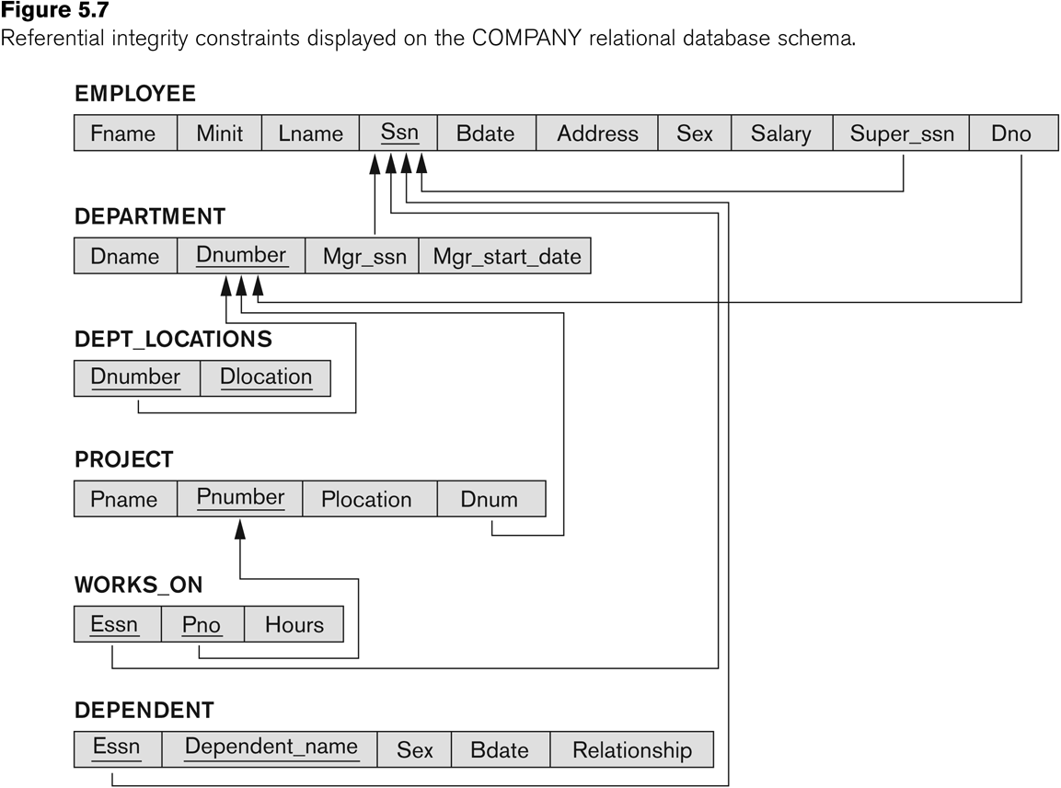
Database State for COMPANY
All examples discussed below refer to the COMPANY database shown here.

Slide 8
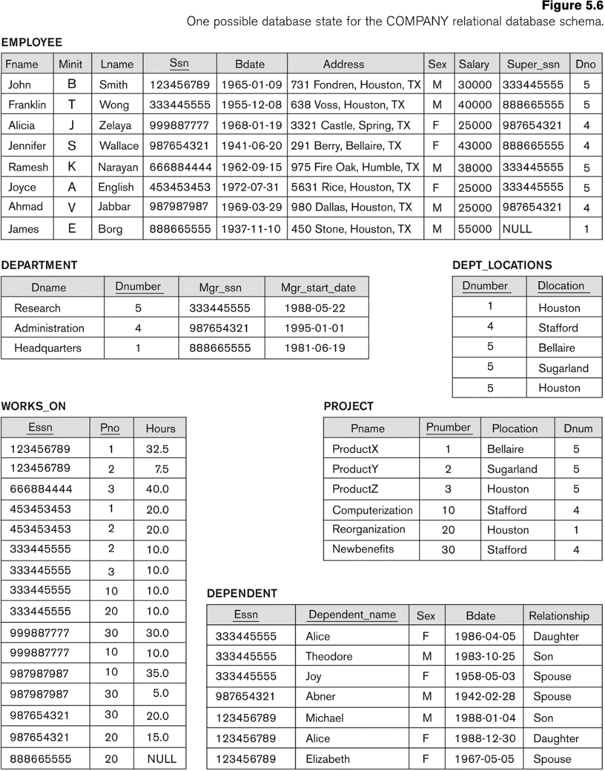

Slide 9


Unary Relational Operations: SELECT
The SELECT operation (denoted by σ (sigma)) is used to select a subset of the tuples from a relation based on a selection condition.
  The selection condition acts as a filter
  Keeps only those tuples that satisfy the qualifying condition
  Tuples satisfying the condition are selected whereas the other tuples are discarded (filtered out)
Examples:
  Select the EMPLOYEE tuples whose department number is 4:
σ _{DNO = 4} (EMPLOYEE)
  Select the employee tuples whose salary is greater than $30,000:
σ _{SALARY > 30,000} (EMPLOYEE)

Slide 10
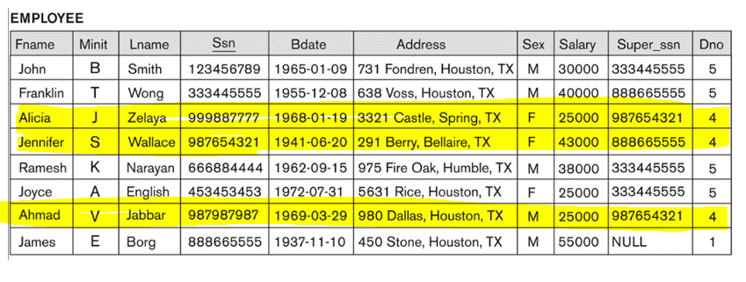
Examples:
  Select the EMPLOYEE tuples whose department number is 4:
res= σ _{DNO = 4} (EMPLOYEE)

Slide 11
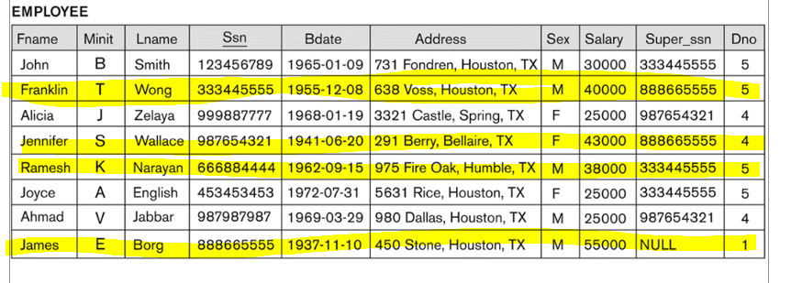
Examples:
  Select the employee tuples whose salary is greater than $30,000:
σ _{SALARY > 30,000} (EMPLOYEE)

Slide 12
Unary Relational Operations: SELECT
  In general, the select operation is denoted by σ _{<selection condition>}(R) where
    the symbol σ (sigma) is used to denote the select operator
    the selection condition is a Boolean (conditional) expression specified on the attributes of relation R
    tuples that make the condition true are selected
      appear in the result of the operation
    tuples that make the condition false are filtered out
      discarded from the result of the operation

Slide 13
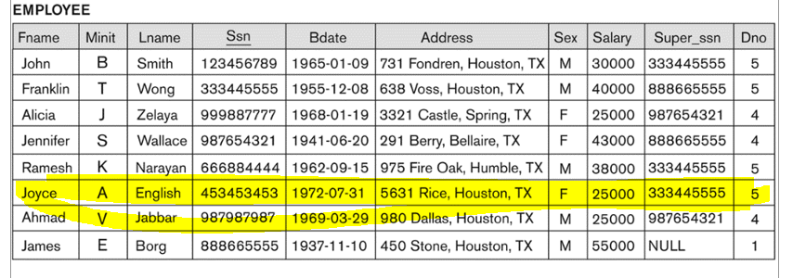
Unary Relational Operations: SELECT- Example
Get all information about females working in department 5
      σ _{DNO = 5 AND sex = “F”} (EMPLOYEE)
Get the names of all males employees either having a salary greater than 30000 or working in department number 5
      σ sex = “M” AND (salary >30000 or dno = 5) (EMPLOYEE)

Slide 14
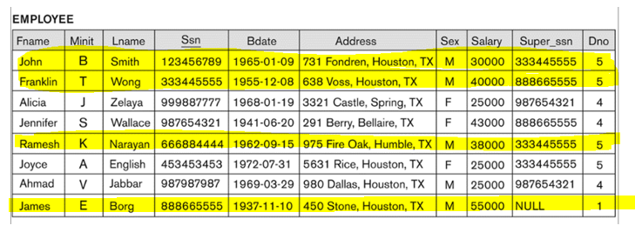
Unary Relational Operations: SELECT- Example
Get the names of all males employees either having a salary greater than 30000 or working in department number 5
      σ sex = “M” AND (salary >30000 or Dno = 5) (EMPLOYEE)

Slide 15
Unary Relational Operations: SELECT (contd.)
SELECT Operation Properties
  The SELECT operation σ _{<selection condition>}(R) produces a relation S that has the same schema (same attributes) as R
  SELECT σ is commutative:
    σ _{<condition1>}(σ _{< condition2>} (R)) = σ _{<condition2>} (σ _{< condition1>} (R))
  Because of commutativity property, a cascade (sequence) of SELECT operations may be applied in any order:
    σ_{<cond1>}(σ_{<cond2>} (σ_{<cond3>} (R)) = σ_{<cond2>} (σ_{<cond3>} (σ_{<cond1>} ( R)))
  A cascade of SELECT operations may be replaced by a single selection with a conjunction of all the conditions:
    σ_{<cond1>}(σ_{< cond2>} (σ_{<cond3>}(R)) = σ <cond1> AND < cond2> AND < cond3>(R)))
  The number of tuples in the result of a SELECT is less than (or equal to) the number of tuples in the input relation R

Slide 16
Unary Relational Operations: PROJECT
PROJECT Operation is denoted by π (pi)
This operation keeps certain columns (attributes) from a relation and discards the other columns.
  PROJECT creates a vertical partitioning
    The list of specified columns (attributes) is kept in each tuple
    The other attributes in each tuple are discarded

Slide 17
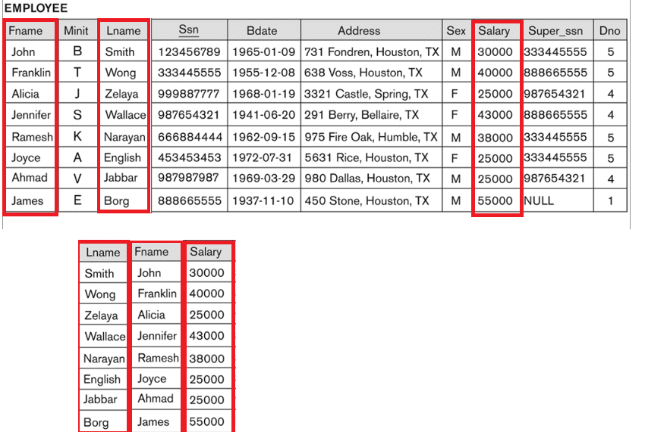
Example: To list each employee’s first and last name and salary
π_{LNAME, FNAME,SALARY}(EMPLOYEE)

Slide 18
Unary Relational Operations: PROJECT (cont.)
The general form of the project operation is:
π_{<attribute list>}(R)
  π (pi) is the symbol used to represent the project operation
  <attribute list> is the desired list of attributes from relation R.
The project operation removes any duplicate tuples
  This is because the result of the project operation must be a set of tuples
    Mathematical sets do not allow duplicate elements.

Slide 19
Unary Relational Operations: PROJECT (contd.)
PROJECT Operation Properties
  The number of tuples in the result of projection π_{<list>}(R) is always less or equal to the number of tuples in R
    If the list of attributes includes a key of R, then the number of tuples in the result of PROJECT is equal to the number of tuples in R
  PROJECT is not commutative
    π _{<list1>} (π _{<list2>} (R) ) = π _{<list1>} (R) as long as <list2> contains the attributes in <list1>

Slide 20
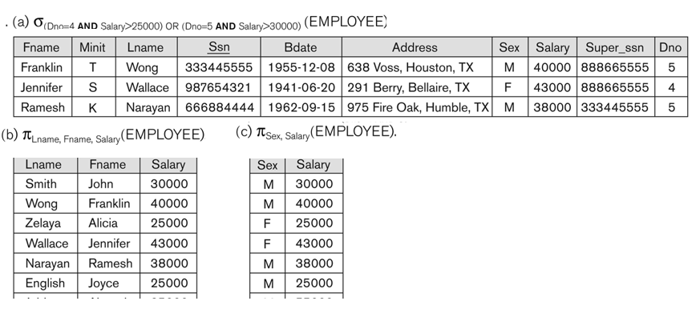

Examples of applying SELECT and PROJECT operations

Slide 21
Relational Algebra Expressions
We may want to apply several relational algebra operations one after the other
  Either we can write the operations as a single relational algebra expression by nesting the operations, or
  We can apply one operation at a time and create intermediate result relations.
In the latter case, we must give names to the relations that hold the intermediate results.

Slide 22
Single expression versus sequence of relational operations (Example)
To retrieve the first name, last name, and salary of all employees who work in department number 5, we must apply a select and a project operation
We can write a single relational algebra expression as follows:
  π_{FNAME, LNAME, SALARY}(σ _{DNO=5}(EMPLOYEE))
OR We can explicitly show the sequence of operations, giving a name to each intermediate relation:
  DEP5_EMPS ← σ _{DNO=5}(EMPLOYEE)
  RESULT ← π _{FNAME, LNAME, SALARY} (DEP5_EMPS)

